Slide 1
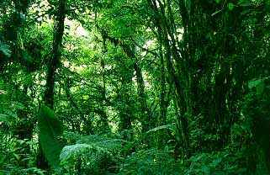
Tropical Rain Forest
Found near the equator

Slide 2
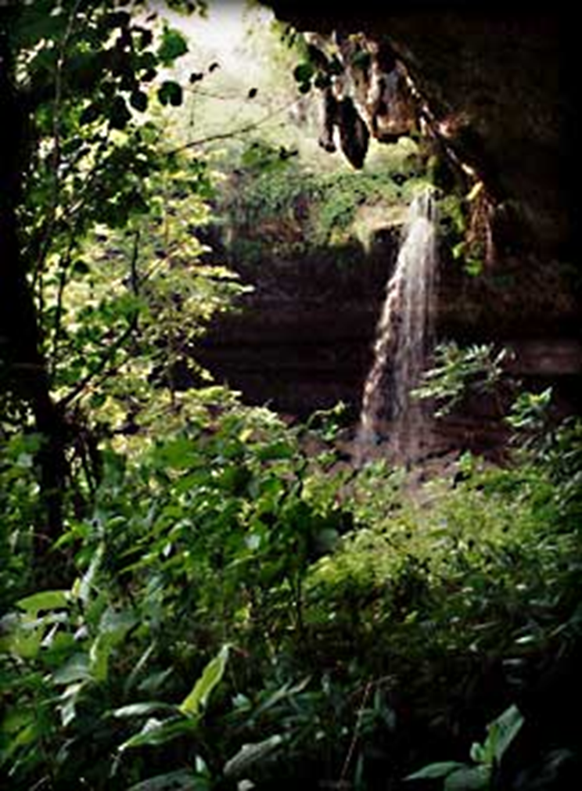
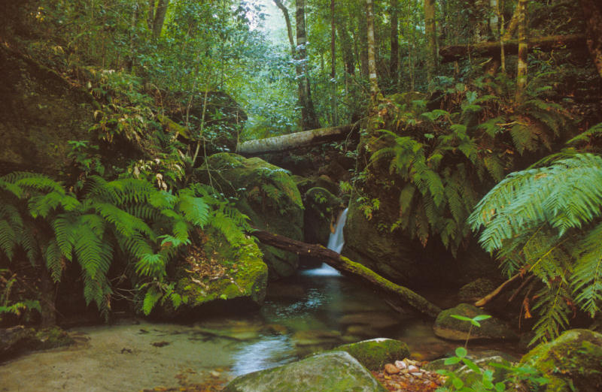
Tropical Rain Forest
Wet and warm climate
Receives lots of rain
Wide variety of plants and animals

Slide 3
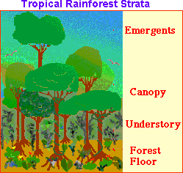
Tropical Rain Forest Layers of Vegetation

Slide 4
Life in the Tropical Rain Forest
The tropical rain forest is a lush, productive ecosystem containing more than half of all the species that live on Earth.

Slide 5
Plants of the Tropical Rain Forest
Examples:
Mahogany trees
Bromeliads and orchids
Giant ferns
Many flowering plants

Slide 6
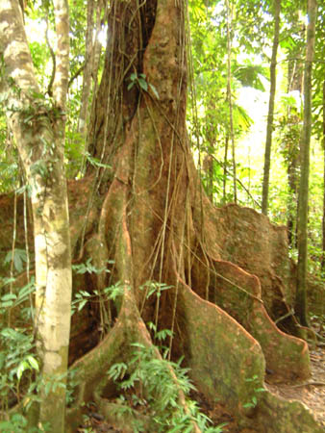
Plants of the Tropical Rain Forest
Mahogany tree
Notice how the roots rise above the ground to help support this giant tree!

Slide 7
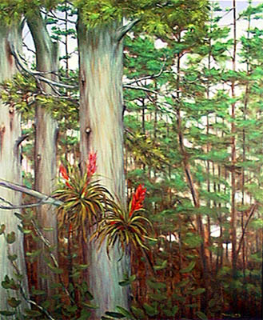
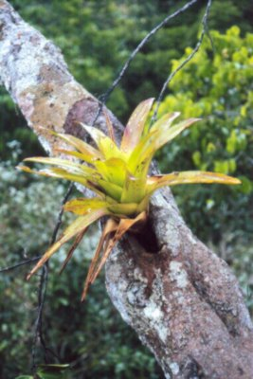
Plants of the Tropical Rain Forest
Bromeliads

Slide 8
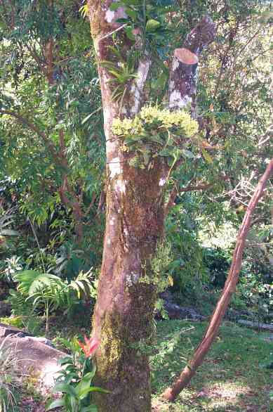
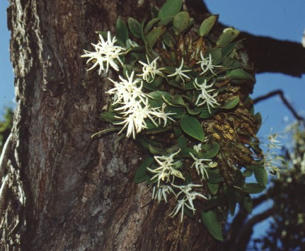
Plants of the Tropical Rain Forest
Orchids

Slide 9
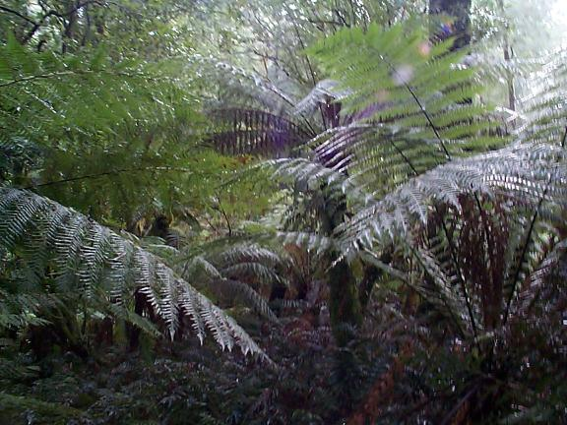
Plants of the Tropical Rain Forest
Giant ferns

Slide 10
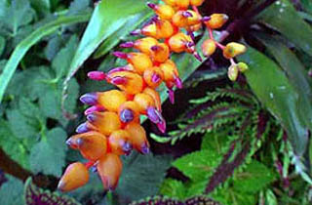
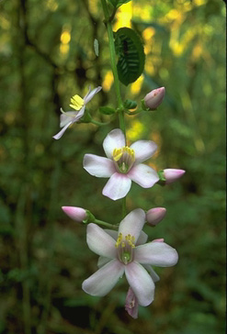
Plants of the Tropical Rain Forest
Flowering plants

Slide 11
Animals of the Tropical Rain Forest
The rain forest is home to a huge number of animals.
Examples:
Monkeys
Exotic birds
Snakes
Sloths
Bats
Insects
Large cats
Exotic mammals

Slide 12
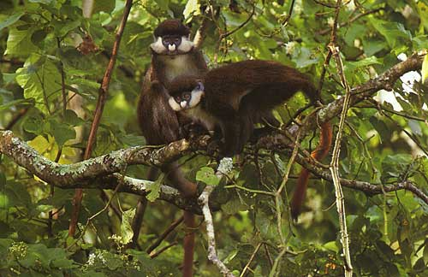
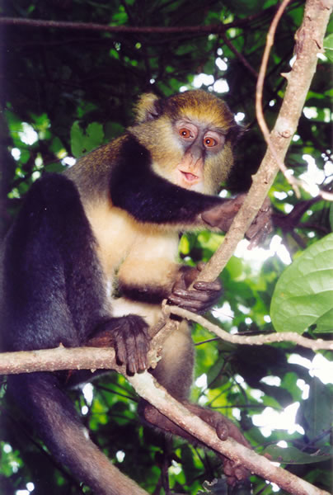
Animals of the Tropical Rain Forest
Monkeys

Slide 13
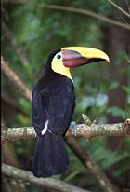
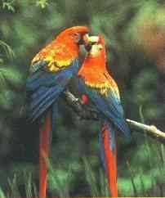
Animals of the Tropical Rain Forest
Exotic birds
Toucan Parrots

Slide 14
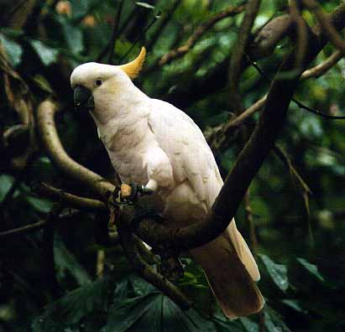
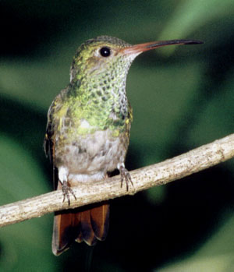
Animals of the Tropical Rain Forest
Exotic birds
Cockatoo Hummingbird

Slide 15
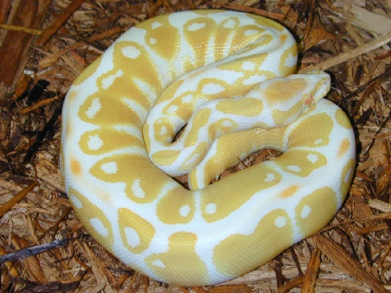
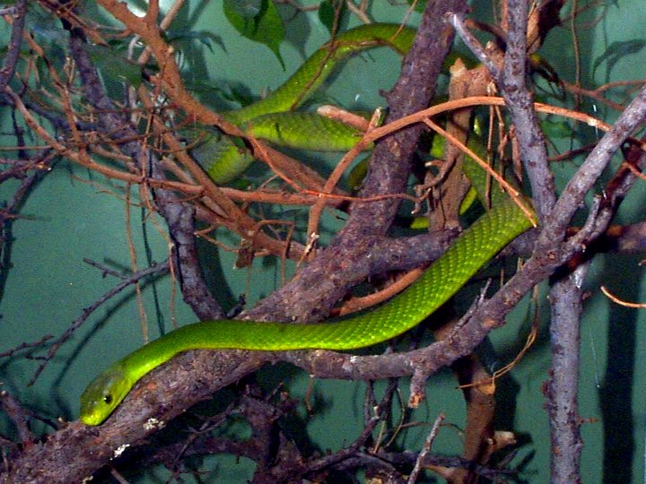
Animals of the Tropical Rain Forest
Snakes
Albino Ball Python Green Mamba

Slide 16
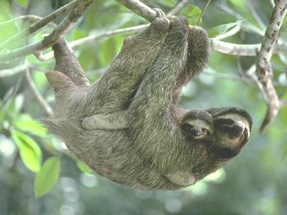
Animals of the Tropical Rain Forest
Sloths

Slide 17
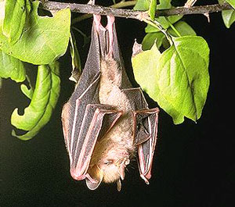
Animals of the Tropical Rain Forest
Bat (Fruit bat)

Slide 18
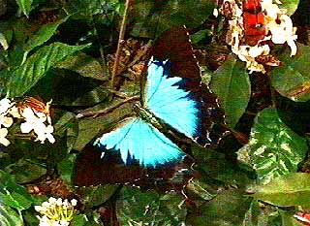
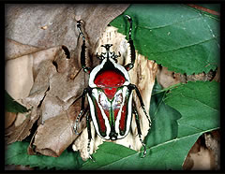
Animals of the Tropical Rain Forest
Insects
Butterfly Beetle

Slide 19
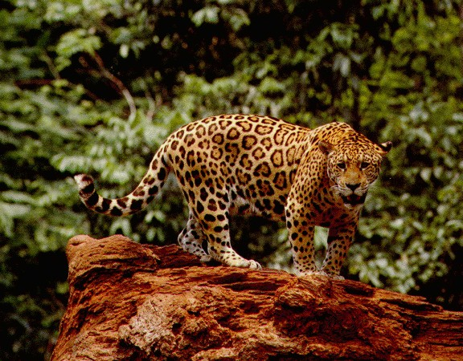
Animals of the Tropical Rain Forest
Large Cats (Jaguar)

Slide 20
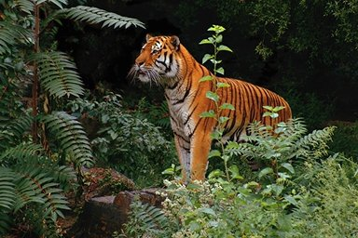
Animals of the Tropical Rain Forest
Large Cats (Sumatran Tiger)

Slide 21
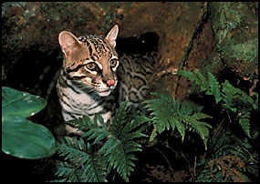
Animals of the Tropical Rain Forest
Large Cat (Ocelot)

Slide 22
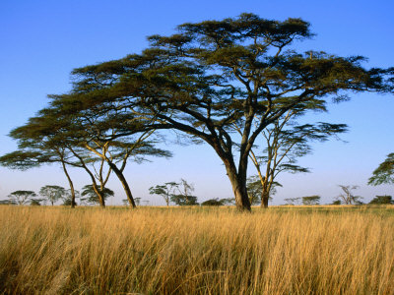
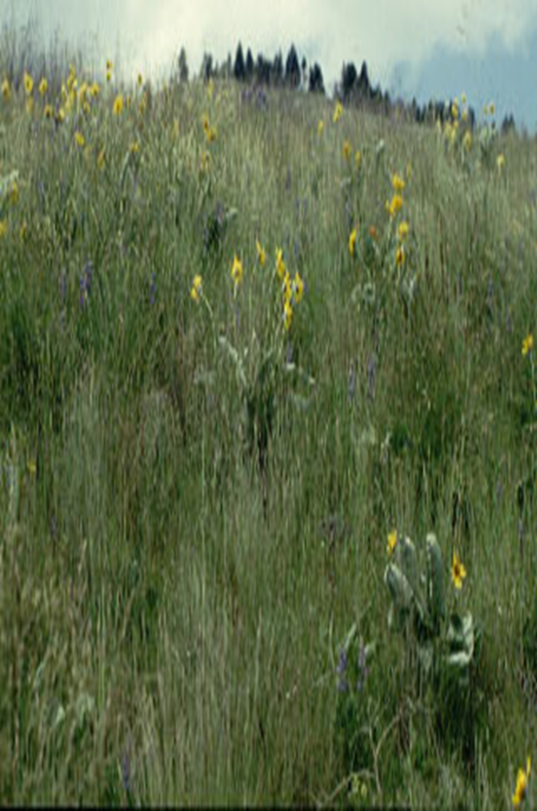
Grassland/Savanna/Prairie
Tall, wild grasses
Small shrubs
The soil is rich and fertile

Slide 23
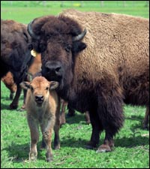
Animals of the Grassland
Bison

Slide 24
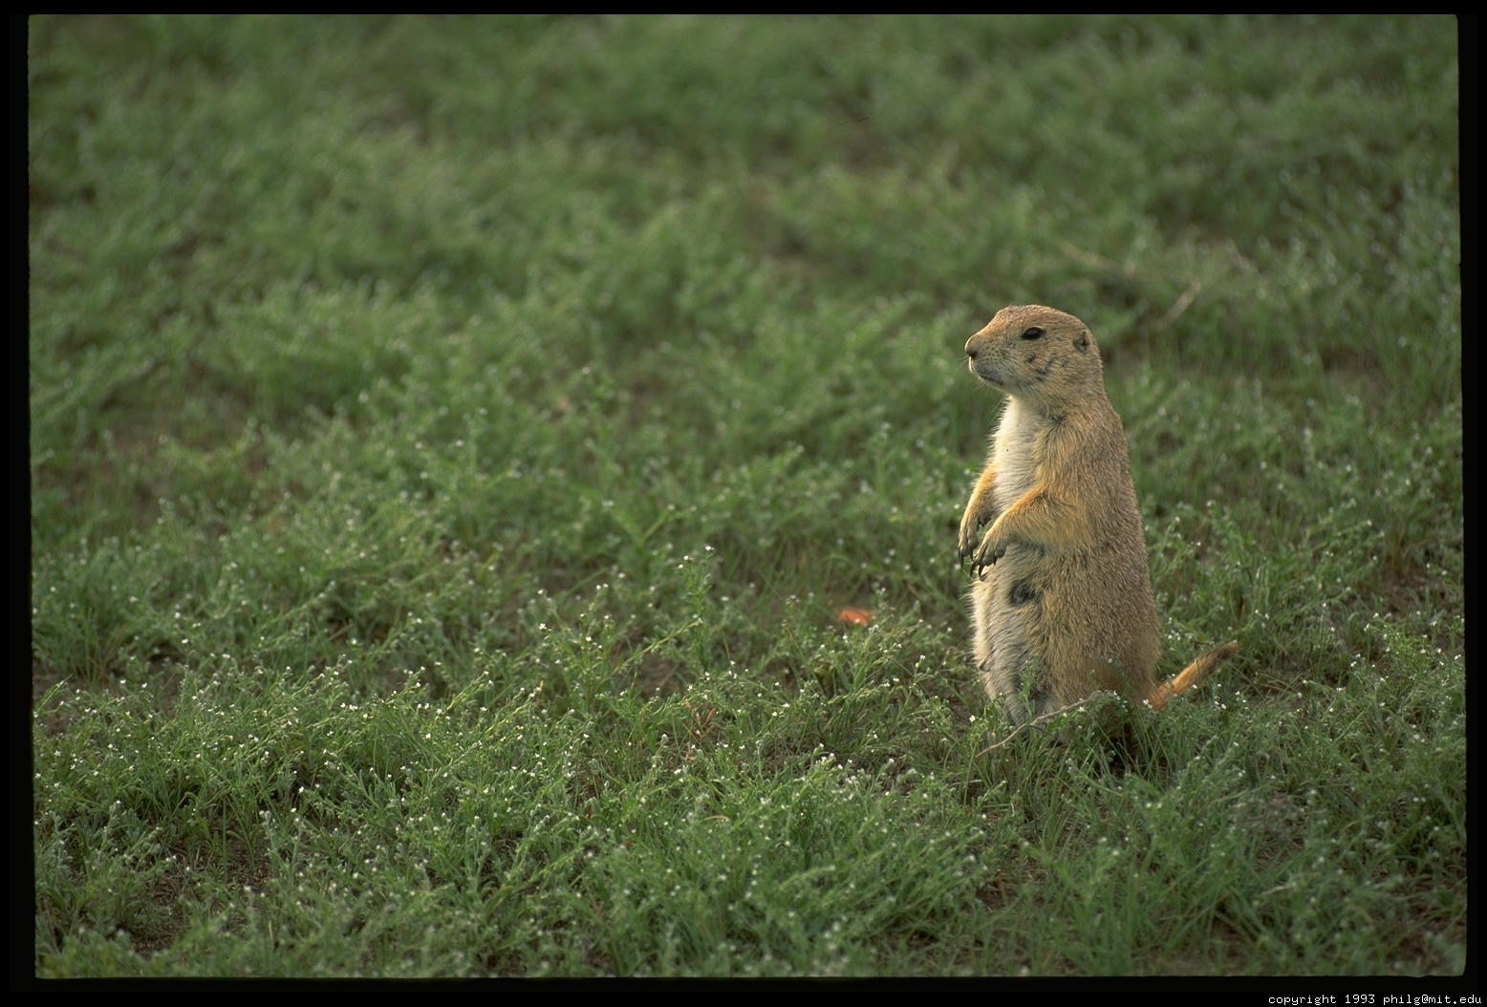
Animals of the Grassland
Prairie Dog

Slide 25
Animals of the Savanna (Africa)

Slide 26
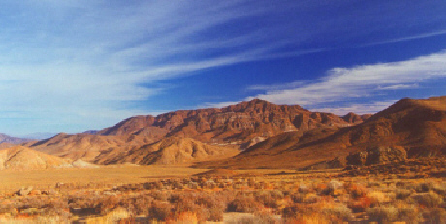
Desert
The driest biome on Earth

Slide 27
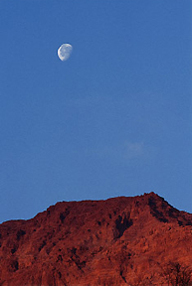
Desert
Hot days/cold nights

Slide 28
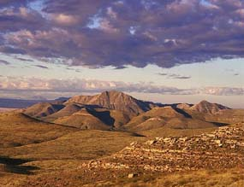
Desert
Very little rainfall
Less than
25 cm precipitation yearly

Slide 29
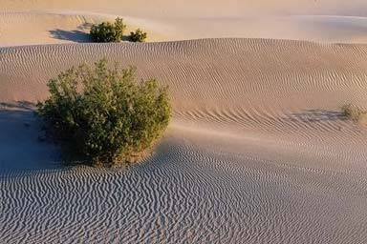
Desert
The soil ranges from gravel to sand.
Soil is nutrient poor.

Slide 30
Plants of the Desert
Desert plants have evolved adaptations to help them survive in the extreme temperatures and dryness of this biome.
Examples:
Cactus

Slide 31
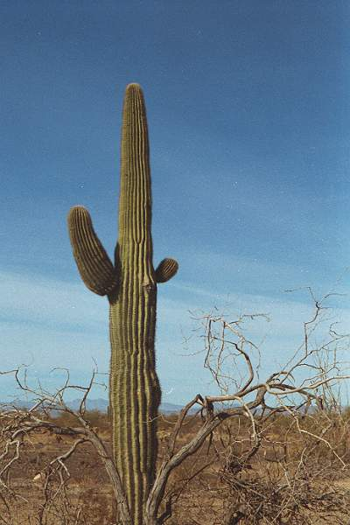
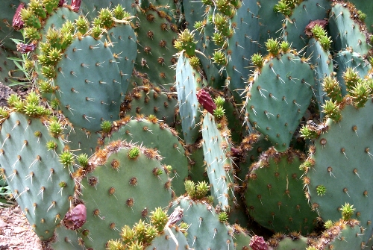
Plants of the Desert
Cactus

Slide 32
Animals of the Desert
The animals of the desert are adapted to the hot temperatures.
Examples:
Lizards
Camels
Snakes
Scorpions
Gila Monster

Slide 33
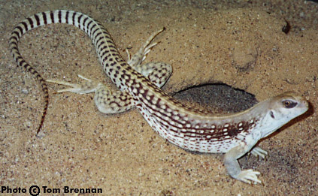
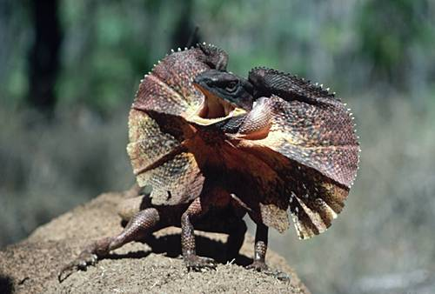
Animals of the Desert
Lizards
Desert Iguana Frilled Lizard

Slide 34
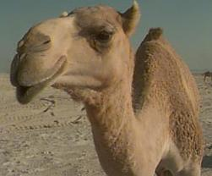
Animals of the Desert
Camel

Slide 35
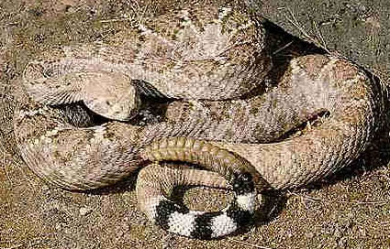
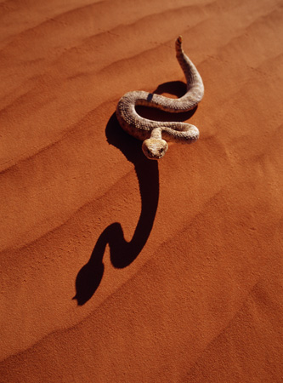
Animals of the Desert
Snakes
Diamondback Rattlesnake Sidewinder

Slide 36
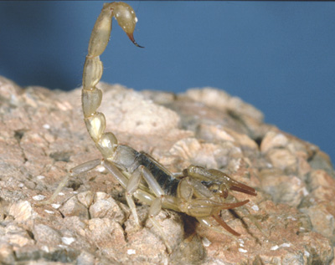
Animals of the Desert
Scorpion

Slide 37
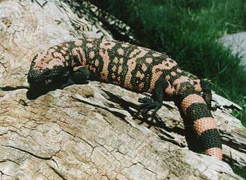
Animals of the Desert
Gila Monster

